Slide 1

SQL Server
What is SQL Server?
It is a software, developed by Microsoft, which is implemented from the specification of RDBMS.

Slide 2
What is Data?
In Simple words data can be facts related to any object.
For Example, Your Name ,Age ,DOB ,photograph, documents etc.(Face Book)

Slide 3


So what is Database?
Database is a systematic collection of data.
Since the data in the database is organized it makes the data management easy.

Slide 4
Relational database
A relational database (RDB) is a collective set of multiple data sets organized by tables, records and columns. RDBs establish a well-defined relationship between database tables.

Slide 5
RDBMS-Relational database Management System
RDBMS- is a program which enables the users to access database, manipulate data, and help in representation of data.
The data in RDBMS is stored in database objects called tables
It also helps control access to the database by various users.

Slide 6
RDBMS-Relational database Management System
Some of the RDBMS systems are:
Oracle
Microsoft SQL server
Sybase etc.

Slide 7
SSMS
SQL Server Management Studio (SSMS) is a software application that is used for configuring, managing, and administering all components within Microsoft SQL Server.
It provides a user-interface for common database tasks.

Slide 8
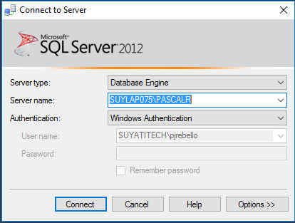
Connecting to SQL Server -SSMS Click “SQL Server Management Studio” on the start menu to launch it.
Click “SQL Server Management Studio” on the start menu to launch it.

Slide 9
MS SQL Server - Login
A login is a simple credential for accessing SQL Server.
Login using Windows authentication.
Login using SQL Server authentication
Logins based on Windows credentials allow you to log in to SQL Server using a Windows username and password. If you need to create your own credentials (username and password,) you can create a login specific to SQL Server.

Slide 10
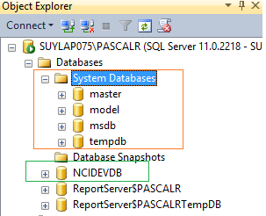
System Databases

Slide 11
System Databases
Master Database: Records all the system-level information for an instance of SQL Server. SQL Server cannot start if the master database is unavailable.
Msdb Database: Is used by SQL Server Agent for scheduling alerts and jobs.

Slide 12
System Databases
Model Database: Is used as the template for all databases created on the instance of SQL Server. Modifications made to the model database, such as database size, collation, recovery model, and other database options, are applied to any databases created afterward.
Tempdb Database: Is a workspace for holding temporary objects or intermediate result sets.

Slide 13
System Databases
Resource Database: Is a read-only database that contains system objects that are included with SQL Server. System objects are physically persisted in the Resource database, but they logically appear in the sys schema of every database.

Slide 14
Creating Database
Database can create by using …
SQL Query
Query Syntax : CREATE DATABASE database_name
Using SSMS
From the Object Explorer select database folder , right click and choose “Create Database”

Slide 15
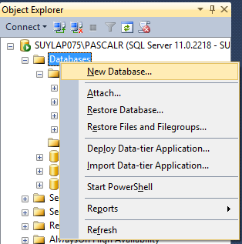
Creating Database from Object Explorer

Slide 16
Structured Query Language(SQL)
Pronounces as “S-Q-L” or sometimes “See-Quel”.
It is actually the standard language, used to query the relational database.
This can be effectively used to “Insert , Update, Search , Delete database records etc ….

Slide 17
SQL Commands
SQL commands are instructions, coded into SQL statements, which are used to communicate with the database to perform specific tasks, work, functions and queries with data.
SQL commands can be used not only for searching the database but also to perform various other functions like, for example, you can create tables, add data to tables, or modify data, drop the table, set permissions for users.

Slide 18
SQL Commands
SQL commands are grouped into four major categories depending on their functionality.
a) Data Definition Language (DDL)
b) Data Manipulation Language (DML)
c) Transaction Control Language (TCL) -
d) Data Control Language (DCL)

Slide 19
Data Definition Language (DDL)
These SQL commands are used for creating, modifying, and dropping the structure of database objects. The commands are
CREATE
ALTER
DROP
RENAME, and TRUNCATE.

Slide 20
DDL –Syntax for Tables
CREATE TABLE table_name (column1 datatype, column2 datatype);
ALTER TABLE table_name ADD column_name datatype;
DROP TABLE table_name;
sp_rename 'table_name.old_column', 'new_name', 'COLUMN';
EXEC sp_renamedb 'oldName', 'newName'

Slide 21
Data Manipulation Language (DML)
These are used for storing, retrieving, modifying, and deleting data. DML commands are:
SELECT
INSERT
UPDATE
DELETE

Slide 22
SQL SELECT Statement
The most commonly used SQL command is SELECT statement. SQL SELECT statement is used to query or retrieve data from a table in the database.
A query may retrieve information from specified columns or from all of the columns in the table
To create a simple SQL SELECT Statement, you must specify the column(s) name and the table name.

Slide 23
SELECT Query Syntax
SELECT column_list FROM table-name [WHERE Clause]
“table-name” is the name of the table from which the information is retrieved.
“column_list” includes one or more columns from which data is retrieved.
The code within the brackets is optional.

Slide 24
Insert Query Syntax
INSERT INTO table_name (column1, column2, column3, ...) VALUES (value1, value2, value3, ...);
INSERT INTO Customers (CustomerName, ContactName, Address, City, PostalCode, Country) VALUES ('Cardinal', 'Tom B. Erichsen', 'Skagen 21', 'Stavanger', '4006', 'Norway');

Slide 25
Update Query Syntax
UPDATE table_name SET column1 = value1, column2 = value2, ... WHERE condition;
UPDATE Customers SET ContactName = 'Alfred Schmidt', City= 'Frankfurt' WHERE CustomerID = 1;

Slide 26
Delete Query Syntax
DELETE FROM table_name WHERE condition;
DELETE FROM Customers WHERE CustomerName='Alfreds Futterkiste';

Slide 27
SQL Operators
There are two type of Operators, namely Comparison Operators and Logical Operators.
These operators are used mainly in the WHERE clause, HAVING, clause to filter the data to be selected.
Also used with Delete & Update operations

Slide 28
Comparison Operators
The below table describes each comparison operator.
Comparison Operators | Description
= | equal to
<>, != | is not equal to
< | less than
> | greater than
>= | greater than or equal to
<= | less than or equal to

Slide 29
Logical Operators
There are three Logical Operators namely, AND, OR, and NOT.
Logical Operators | Description
OR | For the row to be selected at least one of the conditions must be true.
AND | For a row to be selected all the specified conditions must be true.
NOT | For a row to be selected the specified condition must be false

Slide 30
Logical Operators Examples
SELECT first_name, last_name, subject FROM student_details WHERE subject = 'Maths' OR subject = 'Science‘
SELECT first_name, last_name, age FROM student_details WHERE age >= 10 AND age <= 15;
SELECT first_name, last_name, games FROM student_details WHERE NOT games = 'Football'

Slide 31
SQL Alias
Basically aliases is created to make the column selected more readable.
Aliases for columns:
SELECT first_name AS Name FROM student_details; or
SELECT first_name Name FROM student_details;

Slide 32
Transaction Control Language (TCL)
These SQL commands are used for managing changes affecting the data. These commands are
COMMIT
ROLLBACK
SAVEPOINT

Slide 33
Data Control Language (DCL)
Data Control Language (DCL) - These SQL commands are used for providing security to database objects. These commands are
GRANT
REVOKE

Slide 34
SQL General Data Types
Each column in a database table is required to have a name and a data type.Developers have to decide what types of data will be stored inside each and every table column when creating a SQL table.
CHARACTER(n) | Character string. Fixed-length n
VARCHAR(n) | Character string. Variable length. Maximum length n
BINARY(n) | Binary string. Fixed-length n
BOOLEAN | Stores TRUE or FALSE values
DATE Time
XML
TIMESTAMP

Slide 35
SQL General Data Types
VARCHAR(n) | Character string. Variable length. Maximum length n
BINARY(n) | Binary string. Fixed-length n
BOOLEAN | Stores TRUE or FALSE values
DATE Time
XML
TIMESTAMP | CHARACTER(n)

Slide 36
SQL PRIMARY KEY Constraint
The PRIMARY KEY constraint uniquely identifies each record in a database table.
Primary keys must contain UNIQUE values, and cannot contain NULL values.
A table can have only one primary key, which may consist of single or multiple fields.

Slide 37
SQL PRIMARY KEY Syntax
CREATE TABLE Persons ( ID int NOT NULL, LastName varchar(255) NOT NULL, FirstName varchar(255), Age int, CONSTRAINT PK_Person PRIMARY KEY (ID) );

Slide 38
SQL FOREIGN KEY Constraint
A FOREIGN KEY is a key used to link two tables together.
A FOREIGN KEY is a field (or collection of fields) in one table that refers to the PRIMARY KEY in another table.
The table containing the foreign key is called the child table, and the table containing the candidate key is called the referenced or parent table.
CREATE TABLE Orders ( OrderID int NOT NULL PRIMARY KEY, OrderNumber int NOT NULL, PersonID int FOREIGN KEY REFERENCES Persons(PersonID) );

Slide 39
SQL FOREIGN KEY Constraint Person Table Order Table
PersonID | LastName | FirstName | Age
1 | Hansen | Ola | 30
2 | Svendson | Tove | 23
3 | Pettersen | Kari | 20
OrderID | OrderNumber | PersonID
1 | 77895 | 3
2 | 44678 | 3
3 | 22456 | 2
4 | 24562 | 1

Slide 40
SQL Index
Index in sql is created on existing tables to retrieve the rows quickly.
When there are thousands of records in a table, retrieving information will take a long time.
When a index is created, it first sorts the data and then it assigns a ROWID for each row.

Slide 41
Clustered Index
A clustered index sorts and stores the data rows of the table or view in order based on the clustered index key.
The clustered index is implemented as a B-tree index structure that supports fast retrieval of the rows, based on their clustered index key values

Slide 42
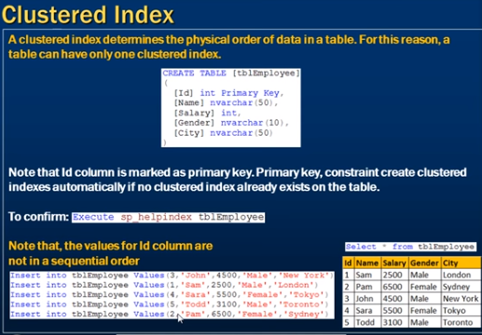
Clustered Index

Slide 43
Nonclustered Index
Each index row in the nonclustered index contains the nonclustered key value and a row locator.
This locator points to the data row in the clustered index or heap having the key value.

Slide 44
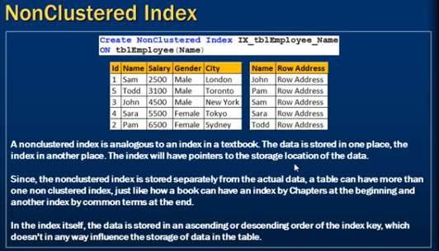

Slide 45
stored procedure
A stored procedure is nothing more than prepared SQL code that you save so you can reuse the code over and over again.
So if you think about a query that you write over and over again, instead of having to write that query each time you would save it as a stored procedure and then just call the stored procedure to execute the SQL code that you saved as part of the stored procedure.

Slide 46
Stored procedure
CREATE PROCEDURE dbo.uspGetAddress @City nvarchar(30)
AS
SELECT *
FROM Person.Address
WHERE City = @City
GO
To call this stored procedure we would execute it as follows:
EXEC dbo.uspGetAddress @City = 'New York'

Slide 47
User Defined Function
A user-defined function is a Transact-SQL that accepts parameters, performs an action, such as a complex calculation, and returns the result of that action as a value.
Create function fnGetEmpFullName
(@FirstName varchar(50),
@LastName varchar(50)
)
returns varchar(101)
As
Begin return (Select @FirstName + ' '+ @LastName);
end

Slide 48
Views
Database views allow you to create "virtual tables" that are generated on the fly when they are accessed.
A view is stored on the database server as an SQL statement that pulls data from one or more tables and (optionally) performs transformations on that data.
CREATE VIEW view_name AS SELECT column1, column2, FROM table_name WHERE condition;
CREATE VIEW dbo.CustomerInfo_V AS Select CustID ,FNAME AS [FIRST NAME] ,LNME AS [LAST NAME] ,UserID FROM dbo.Customer
Select * from CustomerInfo_V

Slide 49
Views
. Views can hide complexity
If you have a query that requires joining several tables, or has complex logic or calculations, you can code all that logic into a view, then select from the view just like you would a table.
2. Views can be used as a security mechanism
A view can select certain columns and/or rows from a table, and permissions set on the view instead of the underlying tables. This allows surfacing only the data that a user needs to see.

Slide 50
Different Types of SQL JOINs
(INNER) JOIN: Returns records that have matching values in both tables
LEFT (OUTER) JOIN: Return all records from the left table, and the matched records from the right table
RIGHT (OUTER) JOIN: Return all records from the right table, and the matched records from the left table
FULL (OUTER) JOIN: Return all records when there is a match in either left or right table

Slide 51
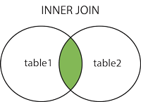
Inner JOIN
(INNER) JOIN: Returns records that have matching values in both tables
INNER JOIN Syntax
SELECT column_name(s) FROM table1 INNER JOIN table2 ON table1.column_name = table2.column_name;

Slide 52
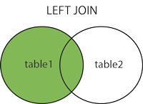
Left JOIN
The LEFT JOIN keyword returns all records from the left table (table1), and the matched records from the right table (table2). The result is NULL from the right side, if there is no match.
SELECT column_name(s) FROM table1 LEFT JOIN table2 ON table1.column_name = table2.column_name;

Slide 53
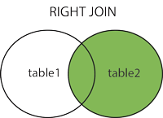
Right JOIN
The RIGHT JOIN keyword returns all records from the right table (table2), and the matched records from the left table (table1). The result is NULL from the left side, when there is no match.
SELECT column_name(s) FROM table1 RIGHT JOIN table2 ON table1.column_name = table2.column_name;

Slide 54
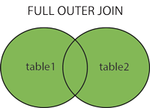
FULL OUTER JOIN
The FULL OUTER JOIN keyword return all records when there is a match in either left (table1) or right (table2) table records.
SELECT column_name(s) FROM table1 FULL OUTER JOIN table2 ON table1.column_name = table2.column_name;

